Slide 1

INTELLIGENCE REPORT 18-001

Slide 2

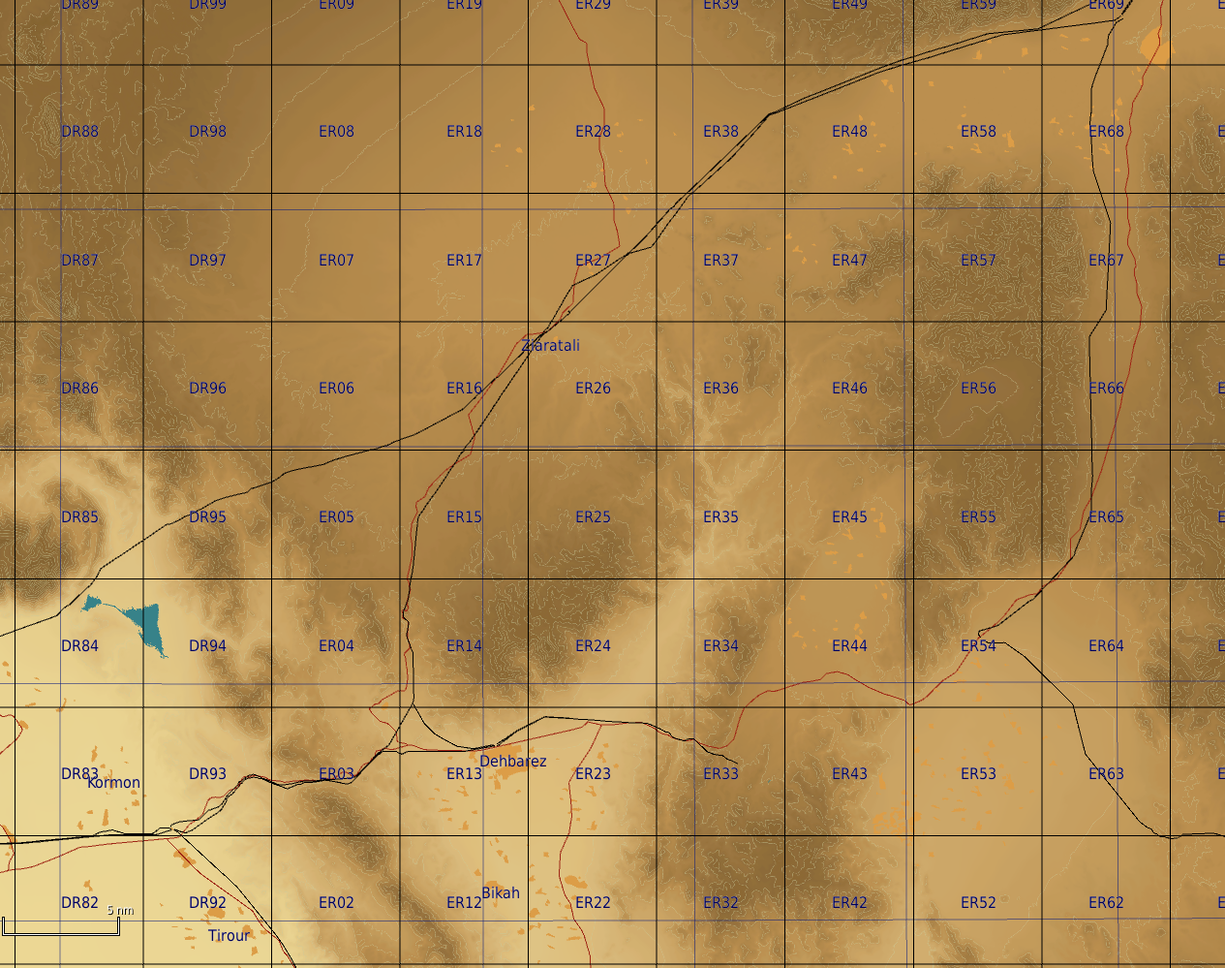
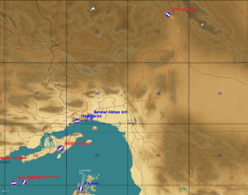
INFORMATION:
In the cover of darkness last night, a small friendly screening force that was located as shown on the map below was in contact with the enemy, and we lost contact with them afterwards.
A couple hours later a convoy that was sent forward to assist and identify what was happening, but after they reported they were in contact with the enemy we lost comms with them.
ASSESSMENT:
It is likely that a large manuver force is moving SOUTH on the easter axis toward friendly forces. This movement seem to be aligned with 151st Armored Regiments movement SOUTH toward our main friendly force.
Screening force
151st Armored Regiment Line of Advance
Friendly convoy
Friendly main force

